Slide 1
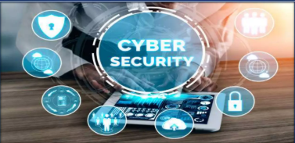
Cybersecurity
ACIT
By Abdullah

Slide 2
Contents
Introduction to Cybersecurity Regulations
Cybersecurity Measures
Sector-Specific Gaps Background and Federal Initiatives
Federal Cybersecurity Regulations State-Level Cybersecurity Efforts
Proposed Federal Legislation
Obama-Era Cybersecurity Initiatives
Other Government Efforts
Conclusion

Slide 3
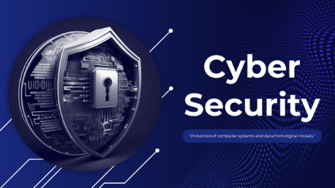
Introduction to Cybersecurity Regulations
Today man is able to send and
receive any form of data may be
an e-mail or an audio or video just
by the click of a button but did he
ever think how securely his data is
being transmitted or sent to the
other person safely without any
leakage of information ?? The
answer lies in cyber security.
Cybersecurity refers to a set of
techniques used to protect the
integrity of networks, programs
and data from attack, damage or
unauthorized access.

Slide 4

Cybersecurity Measures
Tools: firewalls, antivirus, encryption, intrusion detection
Government-private sector collaboration
Regulatory examinations by industry bodies

Slide 5
Sector-Specific Gaps
Maritime industry lacks cybersecurity enforcement
Vulnerabilities in ship-port digital connectivity

Slide 6
Background and Federal Initiatives
2011 DoD Strategy: 5 goals for cyberspace defense
GAO report: Cybersecurity as high-risk area since 1997
2013 DoD rule: NIST compliance, incident reporting, subcontractor obligations
FISMA (2002): Key federal cybersecurity statute

Slide 7
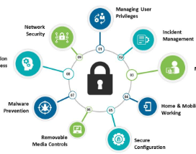
Federal Cybersecurity Regulations
HIPAA (1996), Gramm-Leach-Bliley (1999), Homeland Security Act (2002)
Focus on healthcare, finance, and federal agencies
Limitations: vague language, lack of coverage for ISPs/software firms
Bruce Schneier’s critique: Need for stronger enforcement

Slide 8
State-Level Cybersecurity Efforts
California’s Notice of Security Breach Act (2003)
Assembly Bill 1950 (2004): Extends security obligations to business partners
Other states following California’s lead
Incentives for voluntary cybersecurity investment

Slide 9
Obama-Era Cybersecurity Initiatives
Feb 2013: Executive Order on Improving Critical Infrastructure Cybersecurity
Enhances public-private partnerships
DHS to share threat intelligence
Develops risk-reduction framework
Includes privacy protections
Jan 2015: Cybersecurity Legislative Proposal
Encourages info sharing with liability protection
Modernizes law enforcement tools
Criminalizes overseas sale of financial data
Requires breach notification to consumers

Slide 10

Other Government Efforts
2003: National Strategy to Secure Cyberspace
DHS responsible for security recommendations
Promotes emergency response system
2004: $4.7 billion allocated to cybersecurity
Strategy seen as a framework, not enforcement
CISPA (2013): Encourages breach info sharing, but faced veto threat

Slide 11


Conclusion
Cybersecurity regulations are evolving but fragmented
Need for enforceable, inclusive, and balanced policies
Importance of collaboration across sectors and levels of government

